Slide 1

OOP Project (WS 2022/2023)
Team members:
Muhammad Ali (11160562)
Maryam Jahangir (11159172)
Maximilian Hubert Brandt (11127613)

Slide 2
Regression
Input:
Options for Data set up
Smoothen Data
Train/Test Ratio
Source Data
Column to regress
Data Set Preparation
Original file
Remove duplicates
Remove NA cells
Chose From Drive
Drop Columns
Scale option
Method selection

Slide 3
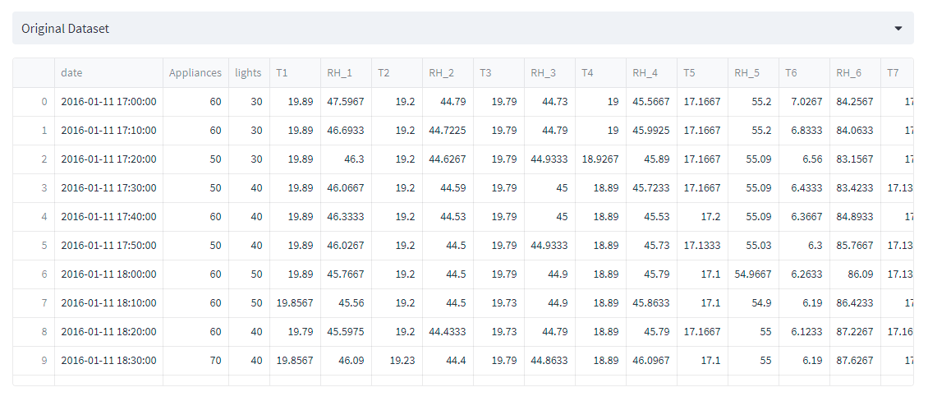
Data Frame
A Data-frame is a two-dimensional data structure in which data is organized in rows and columns.
Many machine learning libraries such as Scikit-learn and TensorFlow accept data in the form of a Data-Frame, making it easy to integrate data preprocessing and analysis into machine learning workflows.
This data come from csv file uploaded or come after performing smoothening, interpolation.

Slide 4
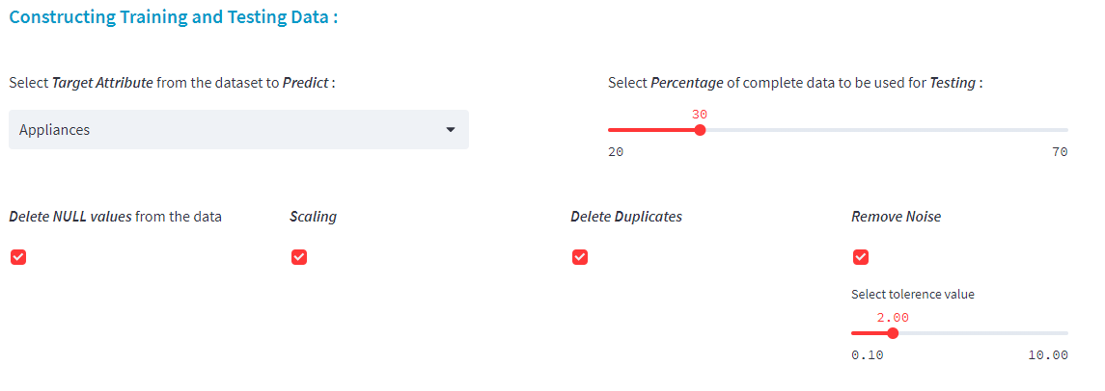
Data preprocessing
Before performing regression, algorithms data need to preprocess in order to improve the results by deleting duplicates, deleting null values and by scaling the data.

Slide 5
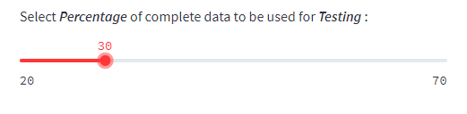
Data Splitting
The very first step is to split the data into two portions with specified ratio.
One is used to train the model with selected method.
And other is used to test that how well the model is trained by finding the R_Square score.
This range can be adjusted by the slider.

Slide 6
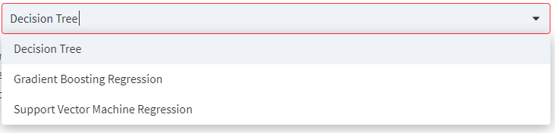
Method Selection
After uploading the data and preprocessing it is needed to select method to be used depending on the type of data.
Selecting appropriate method for specific data is very crucial to get accurate results.

Slide 7
Regression Methods
Method Selection
Gradient Boosting
Support Vector Machine
Decision Tree
GBR work by iteratively adding new models to reduce the errors of previous model and select best one. It is useful when dealing with complex data that require high accuracy. Robustness to outliers.
It works well with both linear and non-linear data and is particularly useful when dealing with high-dimensional datasets. SVM can also handle large datasets efficiently, making it a popular choice for many machine learning applications.
Decision trees can be used to identify important features in a dataset, making them useful for feature selection and reduction of dimensions.
Decision trees are robust to outliers and missing values, making them suitable for use with noisy or incomplete datasets.

Slide 8
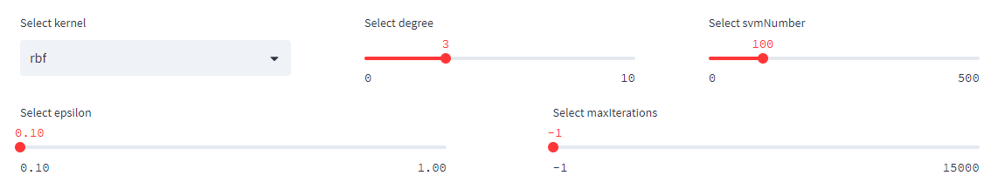
Hyperparameters
Support Vector Machine parameters
Variables to Choose
Kernel
Degree
SVM_Num
Epsilon
Max_iterations
RBF
Linear
Poly
Sigmoid
Range (0 – 10)
Default 3
Range(10 to 500)
Default 100
Range (0.1 – 1)
Default 0.1
Range (1 – 15k)
Default -1

Slide 9
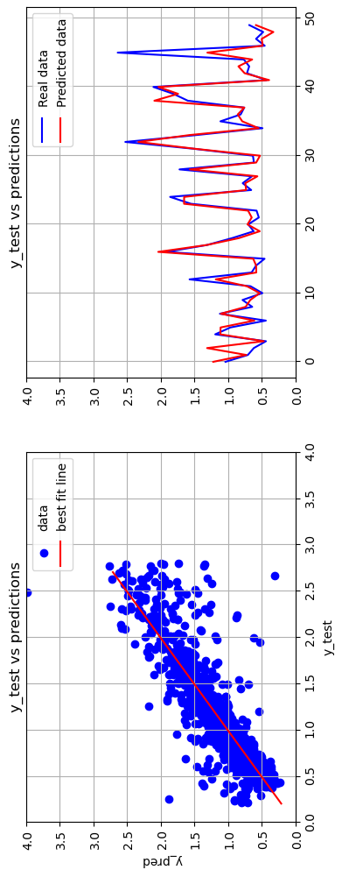
SVM Output
For Test Data
R2 Score [0.805] MSE errors [0.057]

Slide 10
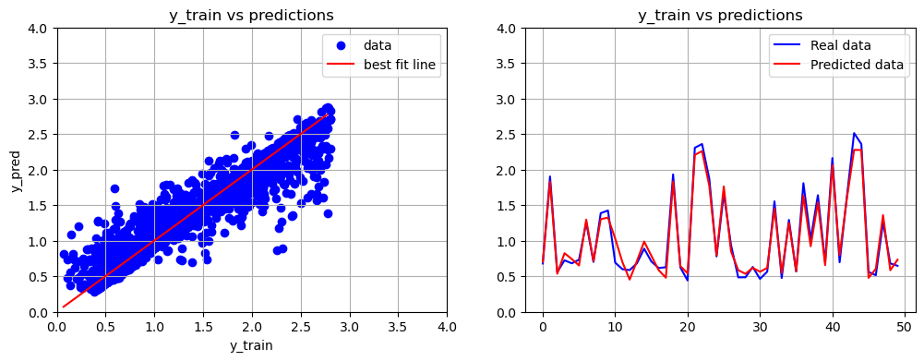
SVM Output
For Training Data
R2 Score [0.929] MSE errors [0.02]

Slide 11
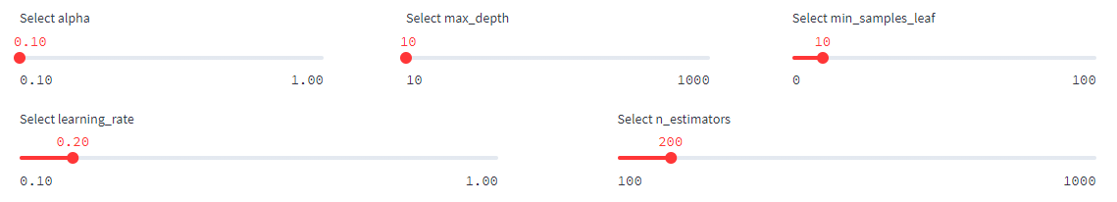
Hyperparameters
Gradient Boosting Regression
Variables to Choose
Max_Depth
Min_Sample_leaf
N_estimator
Alpha
Learning Rate
Range 10 - 1k
Default 10
Range (10 – 100)
Default 10
Range(100 – 1k)
Default 200
Range (0.1 – 1)
Default 0.1
Range (0.1 – 1)
Default 0.2

Slide 12
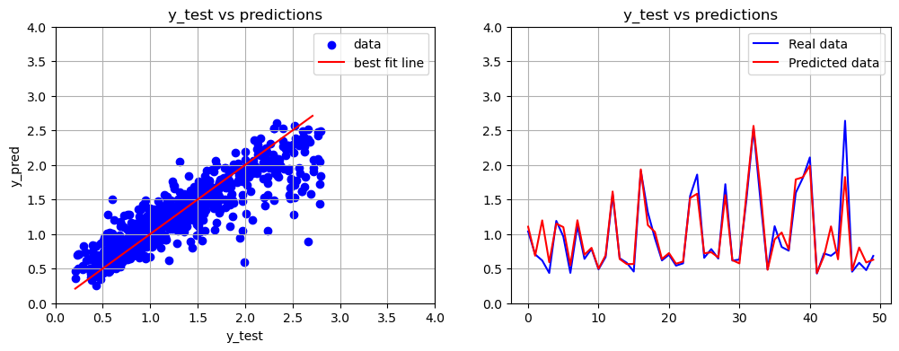
R2 Score [0.857] For MSE errors [0.042]
GBR Output
For Test Data

Slide 13
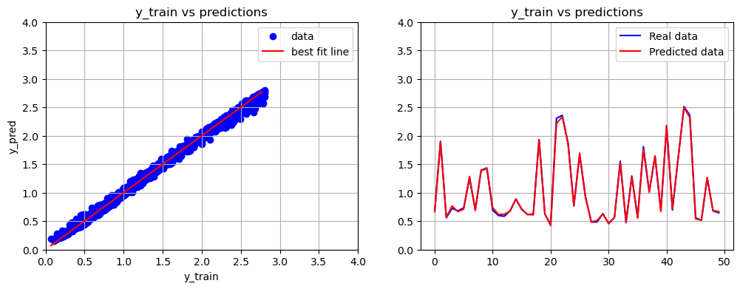
R2 Score [0.997] MSE errors [0.001]
GBR Output
For Training Data

Slide 14
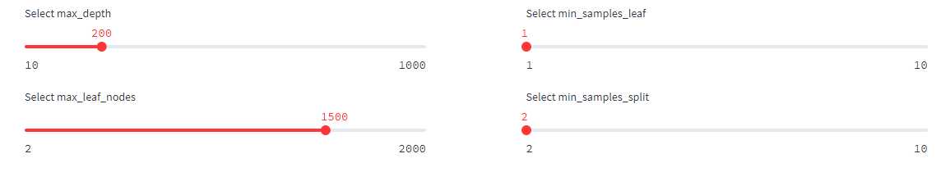
Hyperparameters
Decision Tree
Variables to Choose
Max_Depth
Min_Sample_leaf
Min_sample_split
Max_leaf_node
Range 10 - 1k
Default 200
Range (0 – 10)
Default 1
Range (0 – 10)
Default 2
Range(0 – 2k)
Default 1500

Slide 15
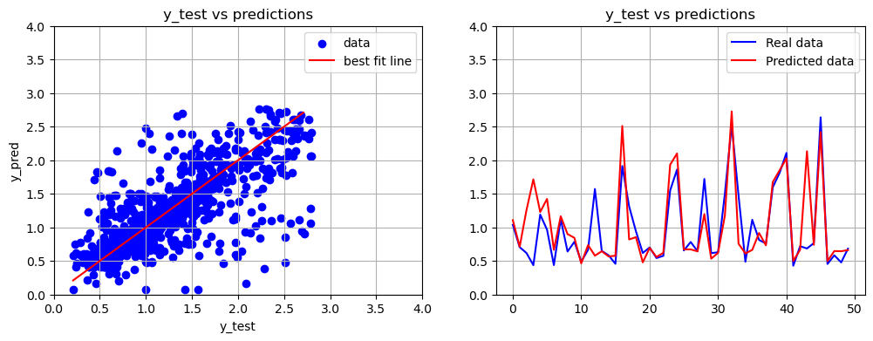
R2 Score [0.675] MSE errors [0.095]
Decision Tree Output
For Test Data

Slide 16
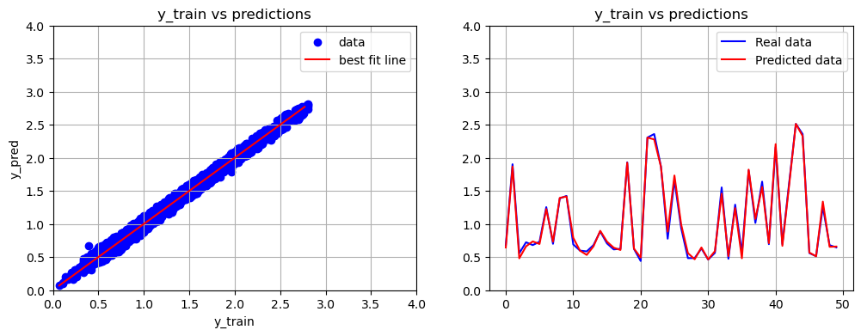
R2 Score [0.994] MSE errors [0.002]
Decision Tree Output
For Training Data

Slide 17
Outputs
Select Regression model
Model Training
Model Graphs
Model Prediction
RMSE
Prediction vs. Actual
R2 Score

Slide 18
Overall Class structure - classification
get_plot
Support Vector Machine
User data
get_results
Classification
K – Nearest Neighbors
selected_column
get_userinput_prediction
Range for X
train_test_split
Logistic Regression
train_model
Get_num_unique_values
Notes:
Inputs for the classification parent class are …
Train_test_split and get_num_unique_values are called in the init and immediatly run when the class is called
All the algroithms have the same 4 methods that are used to display results and train the model

Slide 19
Support Vector Machine class
Support Vector Machine
Kernel
Max_iter
get_plot
get_results
get_userinput_prediction
train_model
fig_train
Bargraph_results
User_testdata
strPredictedClass
gamma
clf
fig
coef0
degree
Notes:
- Results for the methods are the same for every algorithm, will only once go over them
gamma parameter defines how far the influence of a single training example reaches
Large gamma values → points need to be close to be considered in same group
Low values → large radius is considered for grouping points
Degree is the degree of the polynomial kernel function
Coef0 controly how much the model is influenced by high-degree polynomials

Slide 20
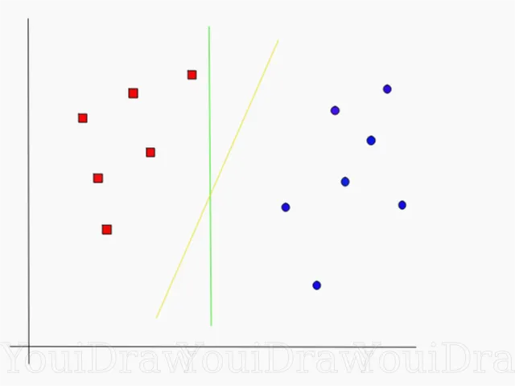
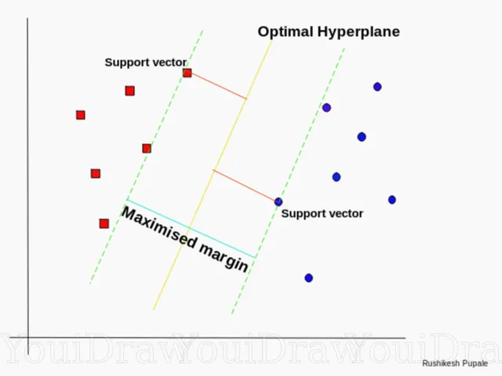
Support Vector Machine class
Fit a straight line
Best decision border
https://miro.medium.com/v2/resize:fit:640/format:webp/1*AMR3v-jCvUMXPUtQskzxmQ.png
https://miro.medium.com/v2/resize:fit:640/format:webp/1*irg_jfdAar9gfe0j-Q04vQ.png
Notes:
- SVM creates a line or plane to seperate classes
- Find points closest to the line (called: support vectors), and maximise the distance/margin to find the hypeplane

Slide 21
Support Vector Machine class
Support Vector Machine
Kernel
Max_iter
get_plot
get_results
get_userinput_prediction
train_model
fig_train
Bargraph_results
User_testdata
strPredictedClass
gamma
clf
fig
coef0
degree

Slide 22
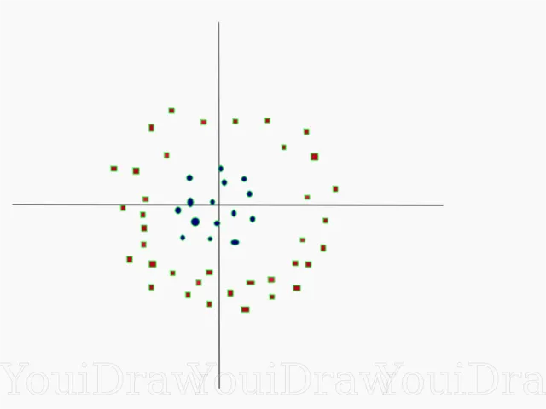
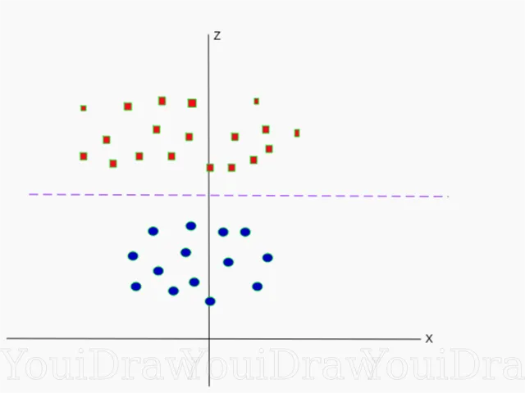
Support Vector Machine class
2D – points (difficult to separate)
Mapped to 3D (easy to separate)
https://miro.medium.com/v2/resize:fit:640/format:webp/1*YY8BOq-WPjRp4QkO1Xoulw.png
https://miro.medium.com/v2/resize:fit:640/format:webp/1*a_TQSZ_H1UOA3BV299qtJQ.png
Notes:
If the points are not sperable by a straight line, we use the kernel trick to map them to a higher dimension where seperating the points might be easier
There are different kernels for different use cases

Slide 23
Logistic Regression class
Logistic Regression
Solver
Max_iter
get_plot
get_results
get_userinput_prediction
train_model
fig_train
Bargraph_results
User_testdata
strPredictedClass
penalty
clf
fig
Random_state
Notes:
Results for the methods are the same for every algorithm, will only once go over them

Slide 24
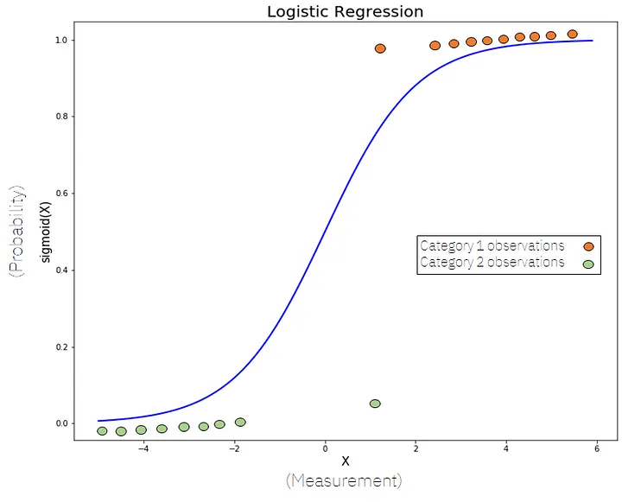
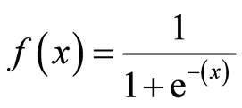
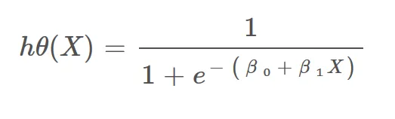

Logistic Regression class
https://miro.medium.com/v2/resize:fit:720/format:webp/1*44qV8LhNzE5hPnta2PaaHw.png
Notes:
- Unlike linear regression (where we fit a straight line) we fit the sigmoid function to our data and calculate a probability which class the point belongs to
Sigmoid function, which is part of the hypothesis, which we use to form the cost function

Slide 25
Logistic Regression class
Logistic Regression
Solver
Max_iter
get_plot
get_results
get_userinput_prediction
train_model
fig_train
Bargraph_results
User_testdata
strPredictedClass
penalty
clf
fig
Random_state
Notes:
Results for the methods are the same for every algorithm, will only once go over them
Solver is an algorithm we use for optimisation problem which is to minimise the error of the loss function
Penalty applies different methods of regularisation
High valued coefficients are penalizied, which reduces the complexity of the model, 3 methods (L1,L2 and Elastic nets)
Shuffles data, relevant for ‘sag’, ‘saga’ or ‘liblinear’
Use a new random number generator (we control this generator with this parameter) seeded by the given integer. Using an int will produce the same results across different calls. Validation with differerent values is suggested
Max iter controls Maximum number of iterations taken for the solvers to converge

Slide 26
K-Nearest Neighbors class
K-Nearest Neighbor
K
get_plot
get_results
get_userinput_prediction
train_model
fig_train
Bargraph_results
User_testdata
strPredictedClass
clf
fig
Notes:
Results for the methods are the same for every algorithm, will only once go over them
Datapoint is classified by majority voting, the mean of the K closest points is taken to predict the class
K decides the number of neighbours that are considered to classify a datapoint

Slide 27
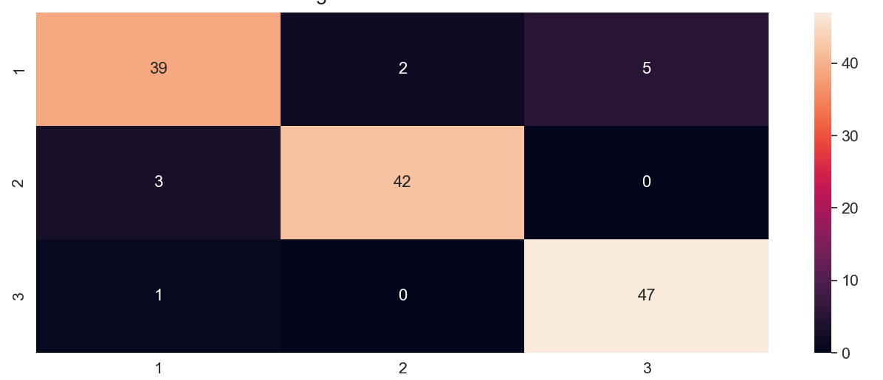
Results
Notes:
- Shows how your predictions versus real data is distributed
You can see how far off the model predicts, which is important in some cases
This matrix is used as a visual aid for the user to easily see the results, but we can derive some metrics from this matrix, which are shown in the following

Slide 28
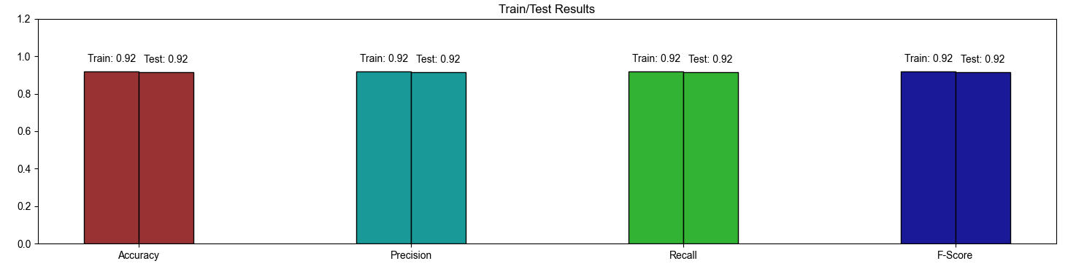
Results

Slide 29
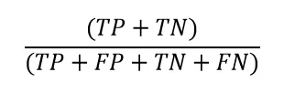
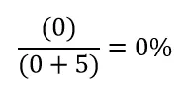


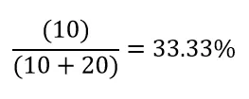
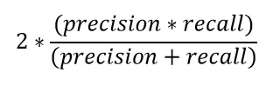
Results
Accuracy
Recall
https://miro.medium.com/v2/resize:fit:620/format:webp/1*qmtdjSnMxZhgS-FpdT_Sqg.png
https://miro.medium.com/v2/resize:fit:364/format:webp/1*Rfo99_NC5O9yr29UukzTeg.png
F1 -Score
Precision
https://miro.medium.com/v2/resize:fit:342/format:webp/1*lagEybn9t5EHZkIZ4tjuXA.png
https://miro.medium.com/v2/resize:fit:624/format:webp/1*nH-SH6R5wOvRNVja-iPw7g.png
Notes:
- Accuracy gives information on how good the algorithm is seperating classes
Since accuracy by itself is not enough, as we might have class imbalance (one class has way more samples)
Thats why we added the other metrics as well
Precision gives you an estimate of how good your positive examples are, what percentage of the positively rated classes were actually positive
Recall: is an intersting metric when there is a class imblance, if the model is bad at predicting the class with only a few cases, it will show up in this score (no true positives and some false negatives)
F1 – Score shows the interplay between precision and recall

Slide 30

Questions

